Slide 1

Library Management System
- Awadha Patrikar
© All rights reserved by Fireblaze Technologies Pvt. Ltd.

Slide 2
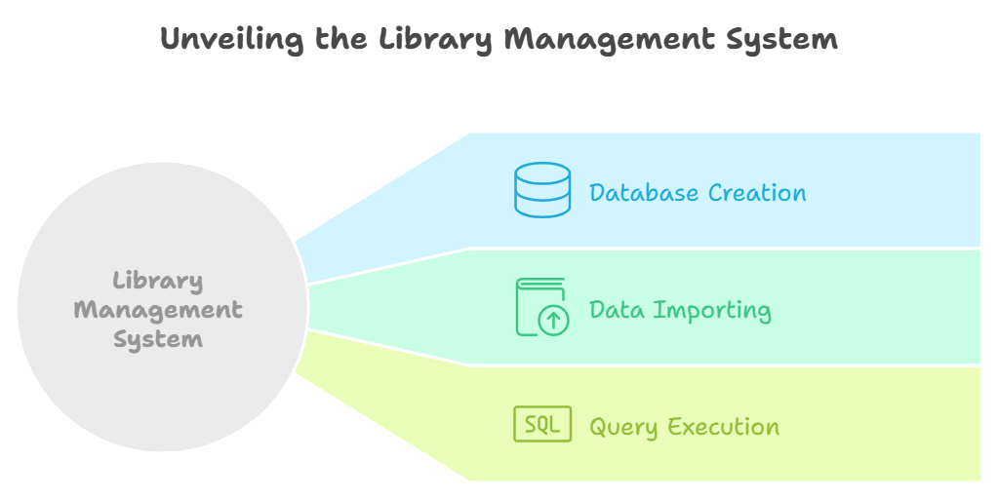
Project Overview
The Library Management System (LMS) project uses MySQL to manage library operations like book rentals, memberships, and employee details. It involves creating a database, importing data, and running queries to analyze performance and optimize operations.
© All rights reserved by Fireblaze Technologies Pvt. Ltd.

Slide 3


Problem Statement
1. How many books are currently available in the library?
SELECT COUNT(*) AS available_books FROM booksWHERE status='yes';
2. What is the total rental income generated by all books?
SELECT SUM(rental_price) as total_rental_price from books;
© All rights reserved by Fireblaze Technologies Pvt. Ltd.

Slide 4
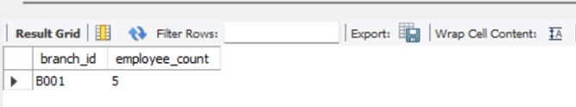
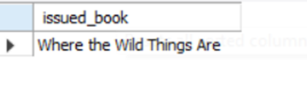
Problem Statement
3. Which branch has the highest number of employees?
SELECT branch_id, COUNT(*) AS employee_count FROM Employees GROUP BY branch_id ORDER BY employee_count DESC LIMIT 1;
4. Which books have been issued the most?
select max(issued_book_name) as issued_book from issued_booksorder by issued_book_name descLimit 3;
© All rights reserved by Fireblaze Technologies Pvt. Ltd.

Slide 5
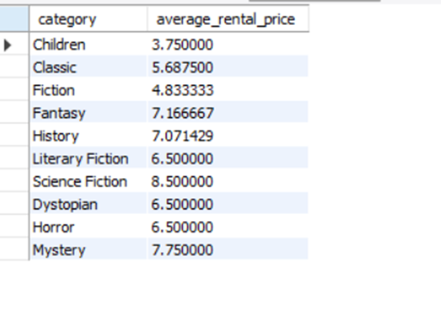

Problem Statement
5. What is the average rental price of books by category?
SELECT category, AVG(rental_price) AS average_rental_price FROM Books GROUP BY category;
6. Which employee has issued the most number of books?
SELECT e.employee_id, e.emp_name, COUNT(i.issued_emp_id) AS total_books_issuedFROM Employees as eJOIN Issued_books as i ON e.employee_id = i.issued_emp_idGROUP BY e.employee_id, e.emp_nameORDER BY total_books_issued DESCLIMIT 1;
© All rights reserved by Fireblaze Technologies Pvt. Ltd.

Slide 6

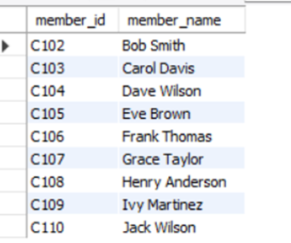
Problem Statement
7. What is the total number of books returned in the last month?
SELECT COUNT(*) AS total_books_returnedFROM return_statusWHERE return_date= YEAR(CURDATE() );
8. List the members who have rented books but not yet returned them ?
SELECT DISTINCT m.member_id, m.member_nameFROM Members mJOIN Issued_Books ib ON m.member_id = ib.issued_member_idLEFT JOIN return_status r ON r.issued_id = ib.issue_idWHERE r.issued_id IS NULL;
© All rights reserved by Fireblaze Technologies Pvt. Ltd.

Slide 7
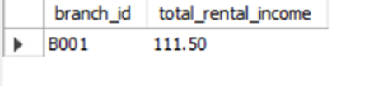

Problem Statement
9. What is the total rental income generated by a partcular branch?
SUM(b.rental_price) AS total_rental_incomeFROM Issued_Books ibJOIN Books b ON ib.issued_book_isbn = b.isbnJOIN Employees e ON ib.issued_emp_id = e.employee_idWHERE e.branch_id = 'B001’
group BY e.branch_id;
10. Which book has been rented the longest without being returned?
ib.issued_book_name AS Book_Name, ib.issue_date AS Issue_Date, DATEDIFF(CURDATE(), ib.issue_date) AS Days_RentedFROM Issued_Books ibLEFT JOIN return_status rs ON ib.issue_id = rs.issued_idWHERE rs.issued_id IS NULLORDER BY Days_Rented DESCLIMIT 1;
© All rights reserved by Fireblaze Technologies Pvt. Ltd.

Slide 8
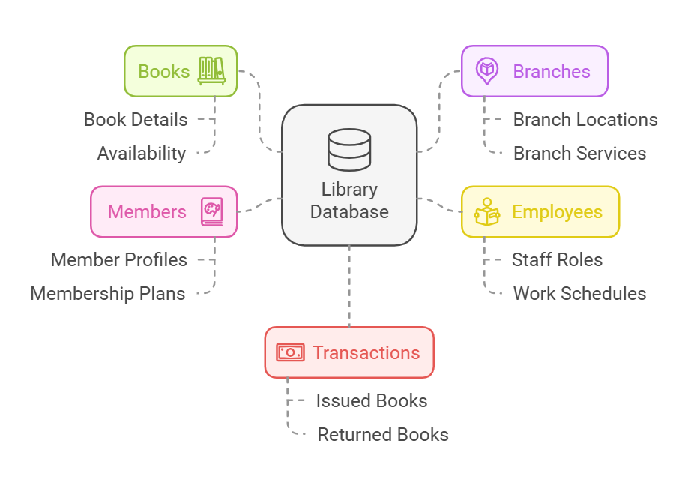
About The Data
© All rights reserved by Fireblaze Technologies Pvt. Ltd.

Slide 9
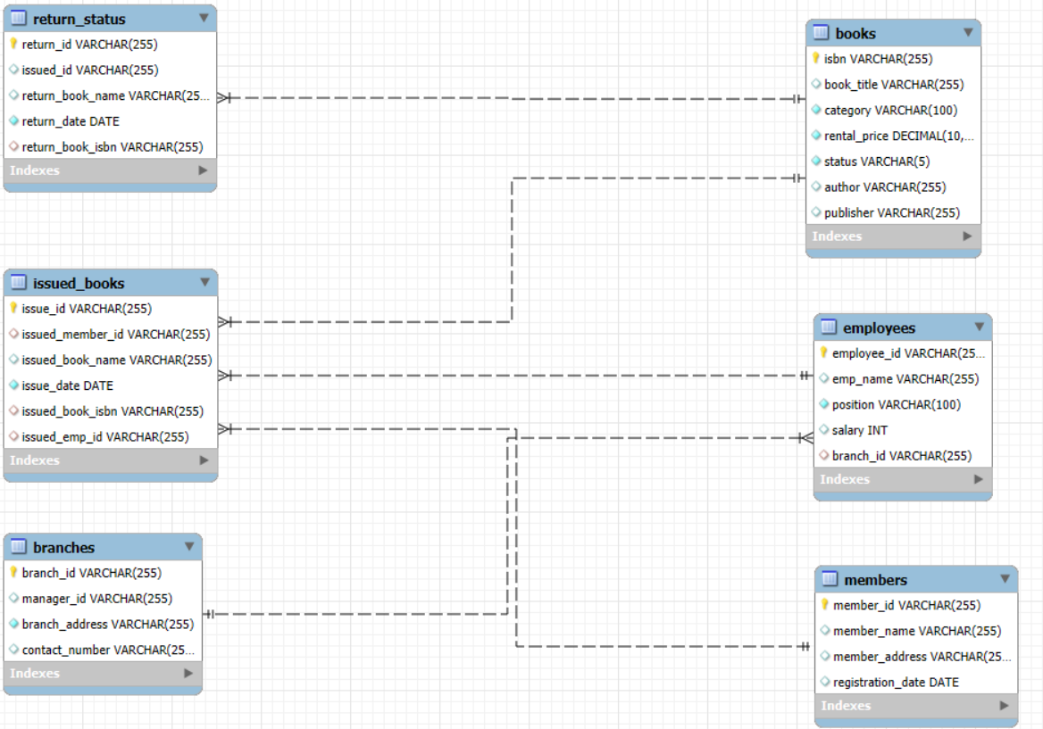
ER Diagram
© All rights reserved by Fireblaze Technologies Pvt. Ltd.

Slide 10
Conclusion
The Library Management System (LMS) Data Analysis project involved designing a MySQL database to manage books, employees, members, and transactions. Through the creation of relevant tables and the execution of SQL queries, the project provided insights into library operations, such as rental income, book availability, and employee performance. The project enhanced skills in database design, data management, and SQL query optimization, offering a comprehensive approach to analyzing library performance.
© All rights reserved by Fireblaze Technologies Pvt. Ltd.

Slide 11
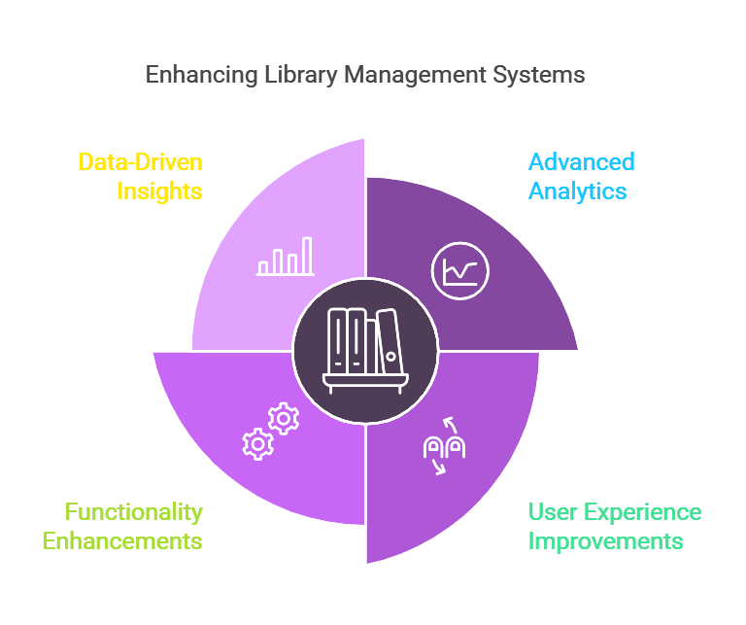
Future Scope
© All rights reserved by Fireblaze Technologies Pvt. Ltd.

Slide 12
Thank You!

